Slide 1
Individual-level prediction of stroke risk following risperidone treatment in dementia AYSEL YUKSEL MSc Health Data Science

Slide 2
Research question:
Aim: Can a person with dementia’s individual clinical history be used to estimate stroke risk if prescribed risperidone?
Understanding the correlation between risperidone and stroke
Generating a new drug is too expensive
Creating a predicting tool
Make risperidone safer, less stroke
Help doctors for their decisions
Outputs ➔ inputs of 13 months funded dementia/stroke risk project.

Slide 3
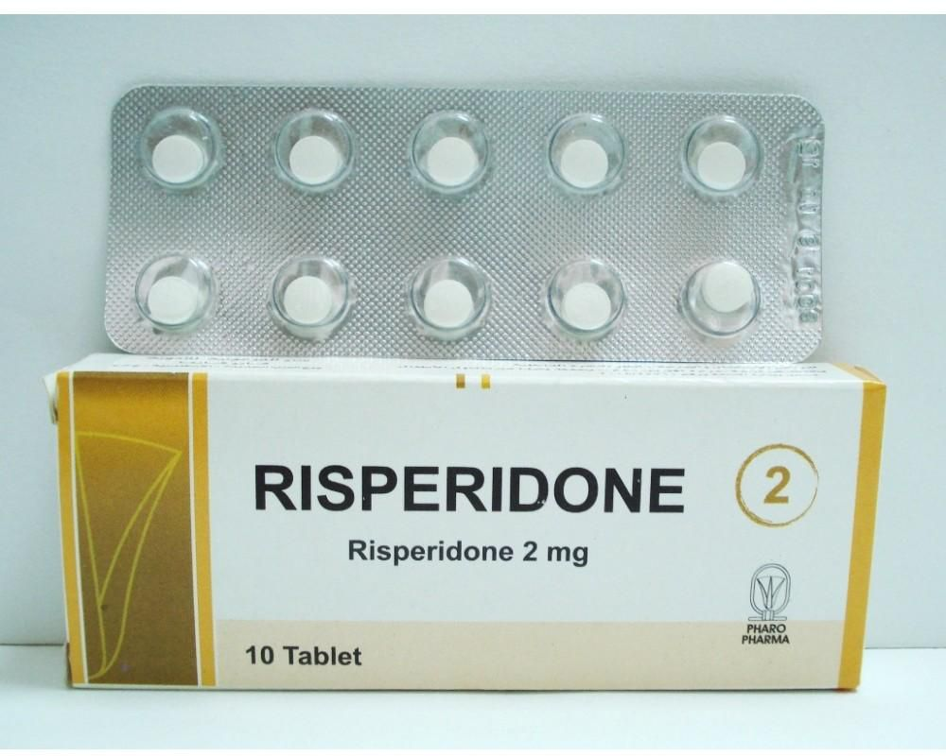

Background : Dementia-Risperidone-Stroke
850, 000 people have dementia in the UK (NHS)
The main symptom of dementia is memory loss
Risperidone is prescribed for agitation, aggression, and psychosis
Risperidone is the only licenced drug in the UK
Risperidone is prescribed to 2% (>8500) of dementia patients annually (8-11)
5.5% of dementia patients in care homes use risperidone (12)
Risperidone has a modest efficacy
Risperidone has significant side effects such as stroke
Previous studies: 27 in 1000 dementia patients have stroke
after risperidone (5)

Slide 4
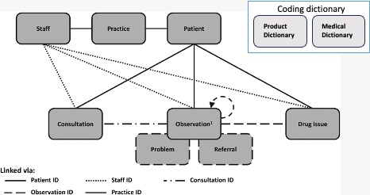
Methods : Dementia-Risperidone-Stroke
Exeter diabetes team
Individual-based mathematical modelling
Cox Regression Models –Type 2 diabetes
49 million patients
13 billion observations
Primary care electronic health data
Clinical Practice Research Datalink – CPRD Aurum database

Slide 5
Med-Codes, Prod-Codes and codelists
Generating Risperidone codelist
Collecting brand and generic names from the internet
Finding production codes from the Production dictionary
Generating Dementia codelist
Clinicians’ previous read and snomed codes and the Exeter diabetes team’s read and snomed codes
Finding med codes from the medical dictionary
Generating other 31(generic names), >200 (brand names) antipsychotic drugs’ codelist
Finding their first prescription date for each patient
Generating stroke codelist
From the Exeter diabetes team old stroke med codes
Challenge: Missing (date of birth) or not up-to-date data
Collecting data from the internet takes too much time and the accuracy problem needs more check
Notes:
Read and snomed are old versions of med codes. CPRD includes med codes. Generating correct codelist is vitally importing
The challenge is to find the up-to-date med-codes by using read and snomed codes

Slide 6
Generating Cohorts
Group 1: patients who diagnosed dementia and have been prescribed risperidone aged>=65
Group 2: patients who diagnosed dementia and have never been prescribed risperidone aged>=65

Slide 7
Results :Flow Chart
Prediction of Stroke Risk
Patients have observations
( n= 15,718,230 )
Excluding patients observed with illnesses different from dementia (n=15,400,042)
All patients with a code for dementia at any time point (n = 318,188)
Excluding acceptable codes equal 0, observation date is null, observation date < year of birth, second or more observation dates (n = 15,820)
Excluding patients who reach age 65 at any time after the study period, the observation date is null, observation date < year of birth
(n = 23,960)
Patients diagnosed with dementia (distinct patients according to their first observation date) (n = 302,368)
WHO reach age 65 at any date during the study period or before ('2000-01-01'-'2021-06-01’) (n = 294,228)
Excluding patients: acceptable codes equal 0, never been prescribed risperidone, earliest dementia codes is after earliest risperidone, risperidone prescription is before age 65 (n=300,433)
Excluding patients whose follow-up ends before they reach 65, prescribed risperidone at any time
(n=2, 581)
RISPERIDONE COHORT (n=1,935)
CONTROL COHORT
(n = 291,647)

Slide 8
Propensity Score – Matchit Package
match_report <- matchit(case_control ~ age + sex , data = df_report2, method = "nearest", distance = "glm", ratio= 10)
10:1 Matching to reduce control group
Nearest Neighbour Method : Make matching on covariates age and sex between cohorts
Propensity scores were estimated with logistic regression
1935*10 = 19,350 risperidone and control cohort

Slide 9
Results - Output Baseline Table
Baseline Table | Risperidone Case | Matched Control
Number of patients | N= 1,933 | N= 17,077
Age (Mean SD) | Mean=90.1 sd=9.13 | Mean=90.5 sd=9.11
Number of females (% female) | N= 1169 – 60.48% | N=10391 – 60.85%
Stroke before risperidone Number of patients (%) | N= 0 | N= 1,531 8.97%
Stroke in 12 months after risperidone Number of patients (%) | N= 0 | N=302 1.77%
Stroke any time after risperidone Number of patients (%) | N=0 | 1,455 8.52%

Slide 10
Discussion – Limitations-Strenghts-Future Studies
Missing Data → Null observations
Data Quality → Observation date < Birth of Year
The Risperidone Cohort has not had any stroke occurrence
Time is limited for further investigations
Collecting data from the internet takes too much time and accuracy problems between the internet web pages
Covariates Age and Sex are used, BMI, blood pressure, cholesterol, etc….
Reusable and readable R codes can be used for other projects
There is not any other project on CPRD (Dementia + Risperidone + Stroke)
Can be used as a framework for other projects

Slide 11
References
Halpern, R. et al. Using electronic health records to estimate the prevalence of agitation in Alzheimer disease/dementia. Int. J. Geriatr. Psychiatry 34, 420–431 (2019).
Ropacki, S. A. & Jeste, D. V. Epidemiology of and Risk Factors for Psychosis of Alzheimer’s Disease: A Review of 55 Studies Published From 1990 to 2003. Am. J. Psychiatry 162, 2022– 2030 (2005).
Katz, I. et al. The efficacy and safety of risperidone in the treatment of psychosis of Alzheimer’s disease and mixed dementia: a meta-analysis of 4 placebo-controlled clinical trials. Int. J. Geriatr. Psychiatry 22, 475–484 (2007).
De Deyn, P. P. et al. Management of agitation, aggression, and psychosis associated with dementia: A pooled analysis including three randomized, placebo-controlled double-blind trials in nursing home residents treated with risperidone. Clin. Neurol. Neurosurg. 107, 497– 508 (2005).
Ma, H. et al. The Efficacy and Safety of Atypical Antipsychotics for the Treatment of Dementia: A Meta-Analysis of Randomized Placebo-Controlled Trials. J. Alzheimer’s Dis. 42, 915–937 (2014).
Tampi, R. R., Tampi, D. J., Balachandran, S. & Srinivasan, S. Antipsychotic use in dementia: a systematic review of benefits and risks from meta-analyses. Ther. Adv. Chronic Dis. 7, 229– 245 (2016).
National Institute for Health and Care Excellence. Decision Aid: Antipsychoticmedicines for treating agitation, aggression and distressin people living with dementia. (2018).
Stocks, S. J. et al. Antipsychotic Prescribing to Patients Diagnosed with Dementia Without a Diagnosis of Psychosis in the Context of National Guidance and Drug Safety Warnings: Longitudinal Study in UK General Practice. Drug Saf. 40, 679–692 (2017).
Mueller, C. et al. Antipsychotic use in dementia: the relationship between neuropsychiatric symptom profiles and adverse outcomes. Eur. J. Epidemiol. 36, 89–101 (2021).
Voorhees, J. R. et al. (-)-P7C3-S243 Protects a Rat Model of Alzheimer’s Disease From Neuropsychiatric Deficits and Neurodegeneration Without Altering Amyloid Deposition or Reactive Glia. Biol. Psychiatry 84, 488–498 (2018).
Tran, C. T. et al. Antipsychotic treatment patterns in Alzheimer’s disease patients with agitation: a cohort study using the UK clinical practice research datalink. Curr. Med. Res. Opin. 38, 409–416 (2022).
Griffiths, A. W. et al. Pro re nata prescribing and administration for neuropsychiatric symptoms and pain in long-term care residents with dementia and memory problems: a cross-sectional study. Int. J. Clin. Pharm. 41, 1314–1322 (2019).
Creese, B., Da Silva, M. V., Johar, I. & Ballard, C. The modern role of antipsychotics for the treatment of agitation and psychosis in Alzheimer’s disease. Expert Rev. Neurother. 18, (2018).
Luo, H. et al. Rates of Antipsychotic Drug Prescribing Among People Living With Dementia During the COVID-19 Pandemic. JAMA Psychiatry (2023) doi:10.1001/jamapsychiatry.2022.4448.
Society, A. Alzheimer’s Society’s view on antipsychotic drugs. https://www.alzheimers.org.uk/about-us/policy-and-influencing/what-we- think/antipsychotic-drugs.

Slide 12
QUESTIONS :
THANK YOU : )

